Slide 1
Module 4: Predicting Outcomes Regression
Nikhil D Jonathan, July 2026

Slide 2
Topics to be covered
Simple linear regression: fit a line, interpret the slope
Multiple regression: adding variables, checking assumptions
Residual diagnostics: what goes wrong and why
Logistic regression: when the outcome is yes/no
Reading and communicating regression output to non-analysts
Hands-on: build, test, and present a regression model end-to-end

Slide 3
What is Simple Linear Regression?
Simple linear regression is a statistical tool used in business analytics to predict or estimate the value of one continuous dependent outcome variable (y) based on a single independent predictor variable (x).
Core Components of a simple linear regression model:
Equation: y = mx + c (where y is the predicted target, x is the input factor, m is the slope, and c is the y-intercept).
Slope (m): Shows the expected change in y for every single-unit increase in x.
Intercept (c): The baseline expected value of y when x equals zero.
R-Squared (R²): Measures how well the independent variable explains the variation in the dependent variable (e.g., an R² of 0.81 means 81% of the variation is explained by the model).

Slide 4
Examples of Simple Linear Regression in Business Analytics
Marketing & Sales:
Advertising and Revenue: Predict total sales (Y) based on daily TV or digital marketing ad spend (X) to measure campaign ROI.
Price Elasticity: Forecast unit demand or consumption drop (Y) relative to changes in a product's price point (X).
Human Resources and Finance
Experience and Salary: Estimate expected employee salary or job performance ratings (Y)using years of prior professional work experience (X).
Claims Cost Estimation: Project expected property or auto insurance claim costs (Y) using the initial severity indicator or policyholder age (X)
Operations and Logistics
Delivery Time and Distance: Estimate total travel time or fuel consumption (Y) for delivery trucks based strictly on the number of miles driven (X).
Processing Time and Satisfaction: Track how customer satisfaction scores (Y) fluctuate based on average service request processing time (X).

Slide 5
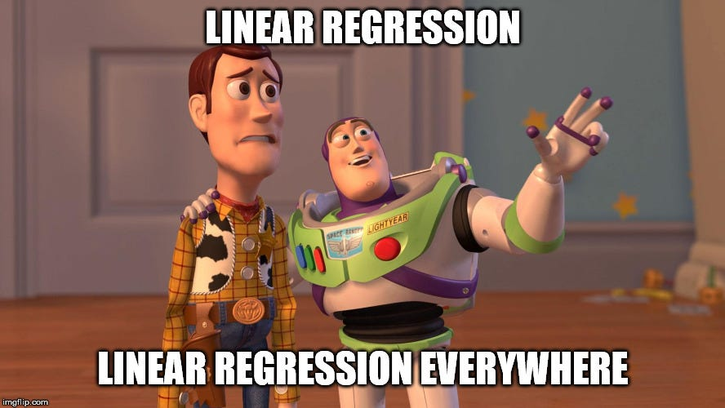

Slide 6
"a result without interpretation is incomplete"
Guidelines for Assessment and Instruction in Statistics Education (GAISE) College Report, American Statistical Association (ASA) (2016)
Notes:
Reference: https://www.amstat.org/docs/default-source/amstat-documents/gaisecollege_full.pdf

Slide 7

Case-let on regression:
You are a business analyst on a agro-commodity trading desk at Kelloggs.
Your P&L depends on next season's US corn yield.
Give me a number for 2027 — and tell me how much to trust it.
"Can a straight line predict next year's harvest?"

Slide 8
OLS Regression Results
==============================================================================
Dep. Variable: Yield_bu_acre R-squared: 0.965
Model: OLS Adj. R-squared: 0.965
Method: Least Squares F-statistic: 2311.
Date: Mon, 24 Aug 2026 Prob (F-statistic): 6.79e-63
Time: 23:08:49 Log-Likelihood: -310.36
No. Observations: 86 AIC: 624.7
Df Residuals: 84 BIC: 629.6
Df Model: 1
Covariance Type: nonrobust
==============================================================================
coef std err t P>|t| [0.025 0.975]
------------------------------------------------------------------------------
const -3640.2778 77.896 -46.733 0.000 -3795.182 -3485.374
Year 1.8879 0.039 48.077 0.000 1.810 1.966
==============================================================================
Omnibus: 25.394 Durbin-Watson: 1.998
Prob(Omnibus): 0.000 Jarque-Bera (JB): 44.603
Skew: -1.156 Prob(JB): 2.06e-10
Kurtosis: 5.665 Cond. No. 1.59e+05
==============================================================================
Notes:
[1] Standard Errors assume that the covariance matrix of the errors is correctly specified.
[2] The condition number is large, 1.59e+05. This might indicate that there are
strong multicollinearity or other numerical problems.

Slide 9
Problem Statement prompt-engineering Exercise
We are to do a business analytics project as a team of post graduate management students, we are interested in the following topics 1,2,3,4; Our project requires us to sharpen our skills in EDA, Linear Regression, Logistic Regression, Decision Tree and K-Means Clustering. We require a problem statement with data available from reputable resources (such as the world bank, statista, google/yahoo finance, uci irvine repository, kaggle or simulated data), provide top 3 problem statement with links to datasets that we can work on. Use the PMP guide on writing the problem statement linked here : https://www.pmi.org/blog/how-to-write-a-problem-statement to craft the statement.

